Slide 1

Bachelor of Computer Application (BCA) – III
Semester - V
Compiler Construction
Unit – I
Dr Liladhar Rewatkar
M. Sc., M. Phil., Ph. D.
Assistant Professor,
Department of Computer Science
Prerna College of Commerce, Reshimbag, Nagpur

Slide 2
Compilers and Translators
As computer understands only machine language and not able to understand the instructions written in high-level (HLL), therefore these high level languages codes have to be translated into the machine level codes for the execution of the programs.
The set of programs that translate the HLL into the low level language is called translators.
The translation rules are very simple and intensive work is carried out by the computer itself.
Programs are designed which are called as translators, it translate source statements or symbolic language into the machine language for a specific computer.

Slide 3

Compilers and Translators
The input to the translator is a program written in a symbolic language and the information output from it is a program in the machine language.

Slide 4
Need of Translator
With the help of machine language we must communicate directly with a computer in terms of bits, register and very primitive operation.
A machine language program is a sequence of 0’s and 1’s. It is very difficult to write complex programs in machine language. It has two main disadvantages.
All operations and operands must be specified in a numeric code.
It is impossible to modify in a convenient manner i.e. writing a program in a machine language is impossible for the programmer.

Slide 5
Need of Translator
Hence we use some other language such as high-level language or assembly language for the programming.
It is very easy to learn and make the program in these languages. But the programs written in such language i.e. HLL or assembly language is not understood by computer.
Hence we must translate this program written in HLL into a machine language and for that we must have a translator which converts a program written in one programming language to a program written in another language.

Slide 6
Important Tasks of Translator
Following are the major tasks or functions of a translator.
Breaks up the up the source program into pieces and impose grammatical structure on them
Allows you to construct the desired target program from the intermediate representation and also create the symbol table
Compiles source code and detects errors in it
Manage storage of all variables and codes.
Support for separate compilation
Read, analyze the entire program, and translate to semantically equivalent
Translating the source code into object code depending upon the type of machine

Slide 7
Types of Translator
Compiler-
It is system software.
It converts HLL program into low-level or binary language program necessary for the execution of program.
The compiler reports to the user the presence of error in the source program if any.
Compiler also converts the source program into a machine form but they themselves do not execute the program.
Every HLL has its own compiler and the object file which is created after the compilation of same source program in different languages has different object file.

Slide 8
Types of Translator
Compiler-
For example, object file for a source program ABC.FOR written in FORTRAN language is differ from the object file for the program written in C language ABC.C

Slide 9
Types of Translator
Interpreter-
An interpreter is a language processor and is similar to the compiler in the sense that it translates the source program written in a high level program.
An interpreter does not produce the machine languages equivalent to the source program.
They translate HLL program into machine language and execute it immediately, provided that there should not be any mistake but here translation is done one line at a time.
The process of translation and execution is carried out for each statement of the source program.

Slide 10
Difference Between Interpreter and Compiler
Interpreter | Compiler
Translate the program line by line Requires less main memory Locating an error is instant Accurate in finding errors It is very easy to debug Good for fast debugging and at testing stage Transaction and execution is simultaneous | Translate the entire program at a time Require more main memory Locating error is not instant It is not much accurate Difficult to debug as compared with interpreter Slow for debugging and testing Transaction and execution are done in two different state

Slide 11
Difference Between Interpreter and Compiler
Interpreter | Compiler
Execution time is more i.e. slow No object file is generated BASIC, JAVA are the examples | Execution time is less i.e. faster Object file is generated C, C++ are the examples

Slide 12
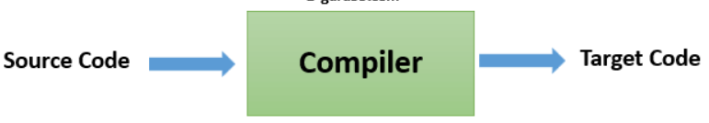
Types of Compiler
There are three types of compilers
Single Pass Compiler- In single pass Compiler source code directly transforms into machine code. For example, Pascal language.

Slide 13
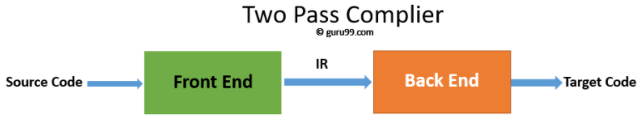
Types of Compiler
Two Pass Compiler- Two pass Compiler is divided into two sections, viz.
Front end: It maps legal code into Intermediate Representation (IR).
Back end: It maps IR onto the target machine
The Two pass compiler method also simplifies the retargeting process. It also allows multiple front ends.

Slide 14
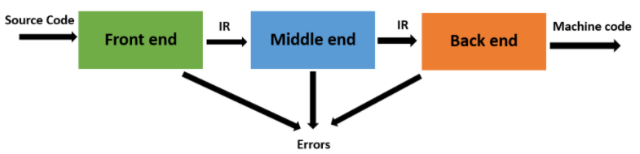
Types of Compiler
Multi Pass Compiler- The multipass compiler processes the source code or syntax tree of a program several times. It divided a large program into multiple small programs and process them. It develops multiple intermediate codes. All of these multipass take the output of the previous phase as an input. So it requires less memory. It is also known as 'Wide Compiler'.

Slide 15
Compilation Issues
While designing a compiler one has deal with various issues like
Maintaining data type integrity
Handling complex expression
Handling operator hierarchies
Implementing the scope and rules of the language.
Handling user defined types
Developing appropriate storage mappings for data structures used in the program
Implementing the semantics of the HLL control structures
Program optimization etc.

Slide 16
Need of Compiler or Why to Study Compiler
It became necessary to write sequences of codes or programs that would cause these computers to perform the desired operations.
Initially these programs were written in machine language numeric codes that represented the actual machine operations to be performed. For example,
C7 06 0000 0002
The above code represents that instruction to move the number 2 to the location 0000 (hexadecimal).
Writing such codes is extremely time consuming and tedious, and this form of coding was soon replaced by assembly language in which instructions and memory locations are symbolic forms.

Slide 17
Need of Compiler or Why to Study Compiler
For example, the assembly language instruction
MOV X, 2
It is equivalent to the previous machine instruction. The symbolic codes and memory locations of assembly language are translated into the corresponding machine codes by assembler. Assembly language has number of defects.
It is not easy to read and write.
It is extremely dependent on the particular machine for which it was written, so code written for one computer must be completely rewritten for others.

Slide 18
Need of Compiler or Why to Study Compiler
So, the next step in programming technology was to write the operations of a program in a concise form using mathematical notations or natural language, in a way that was independent of any one particular machine.
At the same time, the first compiler was under development; Noam Chomsky began his study of the structure of natural language.
His finding made the construction of compiler.
Chomsky’s study led to the classification of languages into four levels of grammars called type 0, type 1, type 2 and type 3 grammars.

Slide 19
Features of Compiler
Compiler verifies entire program, so there are no syntax or semantic errors
The executable file is optimized by the compiler, so it is executes faster
Allows you to create internal structure in memory
There is no need to execute the program on the same machine it was built
Translate entire program in other language
Generate files on disk
Link the files into an executable format
Check for syntax errors and data types.

Slide 20
Features of Compiler
Helps you to enhance your understanding of language semantics
Helps to handle language performance issues
Opportunity for a non-trivial programming project
The techniques used for constructing a compiler can be useful for other purposes as well

Slide 21
Applications of Compiler
Compiler design helps full implementation Of High-Level Programming Languages
Support optimization for Computer Architecture Parallelism
Design of New Memory Hierarchies of Machines
Widely used for Translating Programs
Used with other Software Productivity Tools

Slide 22
Structure or Phases of Compiler
Compiler is a translator that convert source code into object code. Source code are the high level instruction which is converted into the equivalent binary code (Machine Code).
There are different phases that convert the source program into the object program, which is easily understood by system.
Example:-
int A=10
if (A>15)
L=A
else
L=15
(Source code)

Slide 23
Structure or Phases of Compiler
Lexical Analyzer- The first phase lexical analyzer read one by one instruction from the source program and separate all the tokens in the desired format. Token are the instruction & symbols which is logically collected into there separate group.
TOKENS :-
Constant :- 10, 15
Operator :- >, =,
Variable :- l, A, P
Strings :- ‘AAA’, ‘-‘
Special characters :- ‘,’, @, $
Keywords :- if, else, int…...

Slide 24
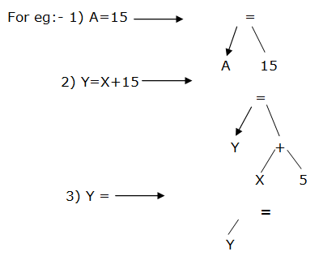
Structure or Phases of Compiler
2) Syntax Analyzer- The second phase syntax analyzer create parse tree & check the given syntax properly use by the user. If tree is not generated successes fully then error transfer to the error handler.

Slide 25
Structure or Phases of Compiler
3) Intermediate Code Generator- The third phase intermediate code generator read the actual value for the variable & returns the desired result. This phase Sign the actual value for the variable.
For ex:- 1) if A=10 then,
L=15
2) if A=100 then,
l=100

Slide 26
Structure or Phases of Compiler
4) Code Optimization- The code phase, code optimization is optimal & it increases the speed of the programmer. Code optimization creates dummy variable & reduce the program length.
For ex :- Y = A + B + C + 10;
X = (A + B + C) / 3
Z = (A + B + C * 6.2);
T = (A + B + C);
Y = T + 10; X = T / 3; Z = T * 6.2
Here y, x, z is actual variable & T is dummy variable.

Slide 27
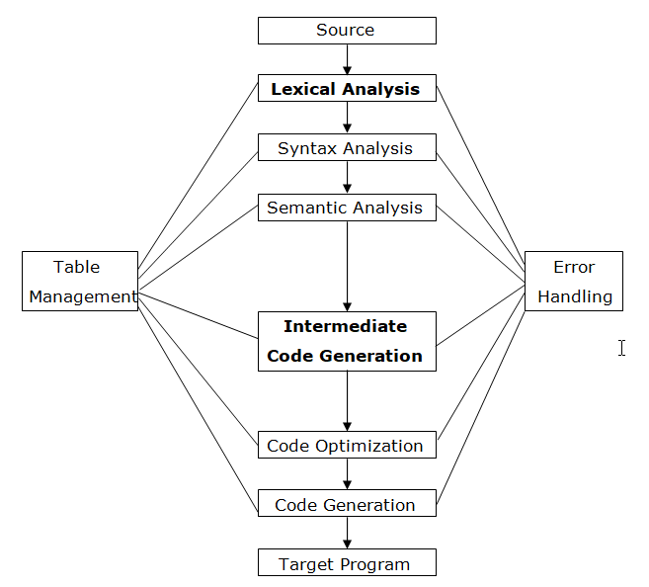
Structure or Phases of Compiler

Slide 28
Structure or Phases of Compiler
5) Code Generator- The fifth phase convert source program into the binary code (machine code) directly use by the system and print the information. Object code in the form of 0 & 1 which is directly transferred to the CPU.
6) Table Management- The supported phase table management reserved sufficient memory for every variables such as
integer: - 2 bytes
float or Real :- 4 bytes
char :- 1 bytes

Slide 29
Structure or Phases of Compiler
7) Error Handler- This phase detect an error from different phases & display the proper error massage so that user can easily remove this error. Error handler activates depending on the phases. Error handler activates when the error occurs during program execution. The common error messages are “undefined symbol”, “statement not terminates with semicolon”, “undefined data type” etc.

Slide 30
Passes of Compiler
A phase is a logically operation that takes as input one representation of the source program and produce as output another representation.
For example, lexical analyzer takes input as source program and produce output as a stream of tokens.
In an implementation of compiler, portion of one or more phase are combined into a module called as a pass.
A pass reads the source program or output of the previous pass makes the transformation specified by its phase and writes output into an intermediate file, which may then be read by a subsequent pass.

Slide 31
Passes of Compiler
If several phases are grouped into one pass, then the operation of the phases may be interleaved, with control alternating among several phases.
Pass | Phase
Pass is a physical scan over a source program (number of times source code is scanned) It creates an intermediate file between each pass Splitting the scanning process into number of passes reduces memory | It is a logically operation that takes as input in one representation of the source program and produces as output in another representation. It does not need any file between phases It reduces a complexity rather than memory

Slide 32
Single Pass and Multi Pass Compiler
A Compiler pass refers to the traversal of a compiler through the entire program. Compiler pass are two types: Single Pass Compiler, and Two Pass Compiler or Multi Pass Compiler. These are explained as following below.
Single Pass Compiler: If we combine or group all the phases of compiler design in a single module known as single pass compiler.

Slide 33
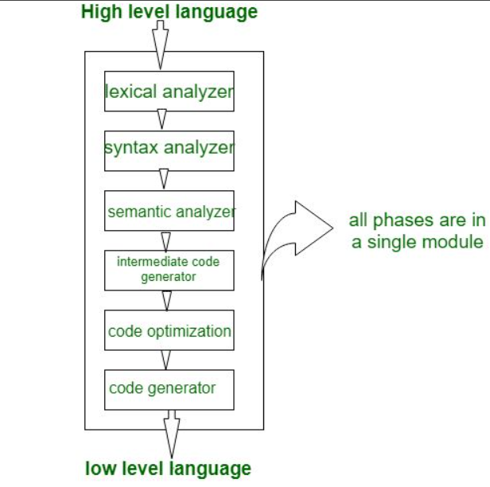
Single Pass and Multi Pass Compiler

Slide 34
Single Pass and Multi Pass Compiler
In above diagram there are all 6 phases are grouped in a single module, some points of single pass compiler is as:
A one pass/single pass compiler is that type of compiler that passes through the part of each compilation unit exactly once.
Single pass compiler is faster and smaller than the multi pass compiler.
As a disadvantage of single pass compiler is that it is less efficient in comparison with multipass compiler.
Single pass compiler is one that processes the input exactly once, so going directly from lexical analysis to code generator, and then going back for the next read.

Slide 35
Single Pass and Multi Pass Compiler
Problems with single pass compiler:
We can not optimize very well due to the context of expressions are limited.
As we can’t backup and process, it again so grammar should be limited or simplified.
Command interpreters such as bash/sh/tcsh can be considered as Single pass compiler, but they also execute entry as soon as they are processed.

Slide 36
Single Pass and Multi Pass Compiler
Two Pass or Multi Pass Compiler: A Two pass/multi-pass Compiler is a type of compiler that processes the source code or abstract syntax tree of a program multiple times. In multipass Compiler we divide phases in two pass as:
First Pass: is refers as
(a). Front end
(b). Analytic part
(c). Platform independent

Slide 37
Single Pass and Multi Pass Compiler
In first pass the included phases are as Lexical analyzer, syntax analyzer, semantic analyzer, intermediate code generator are work as front end and analytic part means all phases analyze the High level language and convert them three address code and first pass is platform independent because the output of first pass is as three address code which is useful for every system and the requirement is to change the code optimization and code generator phase which are comes to the second pass.

Slide 38
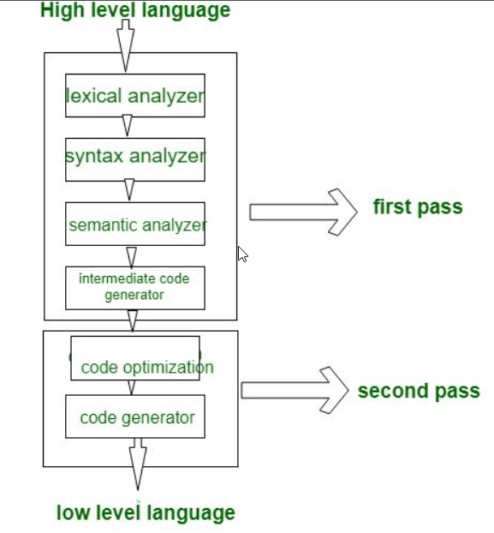
Single Pass and Multi Pass Compiler

Slide 39
Single Pass and Multi Pass Compiler
Second Pass: is refers as
(a). Back end
(b). Synthesis Part
(c). Platform Dependent
In second Pass the included phases are as Code optimization and Code generator are work as back end and the synthesis part refers to taking input as three address code and convert them into Low level language/assembly language and second pass is platform dependent because final stage of a typical compiler converts the intermediate representation of program into an executable set of instructions which is dependent on the system.

Slide 40
Lexical Analysis
The lexical analyzer is the interface between the source program and the compiler.
The lexical analyzer read the source program one character at a time, dividing the source program into a sequence of atomic units is called as tokens.
Each token represent a sequence of character that can be treated as a single logical entity.
A program which performs lexical analysis is termed as a lexical analyzer (lexer), tokenizer or scanner. Lexical analysis consists of two stages of processing which are as follows:
Scanning and Tokenization

Slide 41
Lexical Analysis
Types of Tokens-
Keywords
Identifiers
Constant
Operators
Others separators
For example, consider the following statement in C,
if (a > 10) lar = 10;
Here we find the following seven tokens as
if; (; a; >; 10; lar; =;

Slide 42
Lexical Analysis
Token is substring of the source program that is to be treated as single unit.
In above example,
if is one of keyword or reserved word used in C language.
a and lar are two identifiers
10 is a constant value
> and = are two operators
; is one of the special separators
Every appearance of every identifier and other information is entered at this stage into symbol table which are referred during other phases of compiler.

Slide 43
Lexical Analysis
Tasks of lexical analyzer can be divided into two process:
Scanning: Performs reading of input characters, removal of white spaces and comments.
Lexical Analysis: Produce tokens as the output.
Need of Lexical Analyzer
Simplicity of design of compiler- The removal of white spaces and comments enables the syntax analyzer for efficient syntactic constructs.
Compiler efficiency is improved- Specialized buffering techniques for reading characters speed up the compiler process.

Slide 44
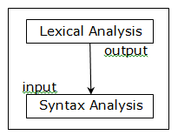
Syntax Analysis
The syntax analyzer or parser has two functions
It checks weather tokens that appears in its input are permitted by specification of source language.
It also imposes on the tokens a tree-like structure that is used by the 3 subsequent phases of the compiler.

Slide 45
Syntax Analysis
For example, if a program contains the expression A+/B
Then after lexical analysis, this expression might appear to the syntax analyzer as the sequence id+/id.
On seeing the /, the syntax analyzer should detect an error situation because the presence of these two adjacent binary operators violates the formation rules of a programming language.
The second aspect of syntax analysis is to make explicit the hierarchical structure of the incoming token stream by identifying which parts of the token should be grouped together.

Slide 46
Syntax Analysis
For example, the expression A / B * C has two possible interpretations.
a) Divide A by B and then multiply by C. or
b) Multiply B by C and then use the result to divide A.
Each of these two interpretations can be represented in terms of a parse tree, a diagram which exhibits the syntactic structure of the expression (EXP). Parse trees that reflect orders (a) and (b) are shown in figure 1 and 2 respectively.

Slide 47
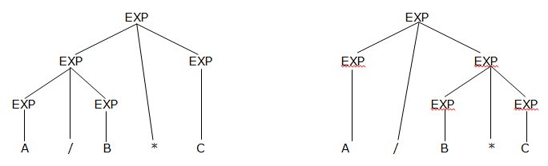
Syntax Analysis
Syntax Analysis of Syntax Analysis of Expression (a) Expression (b)

Slide 48
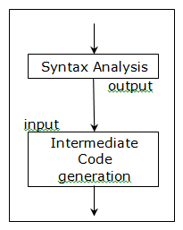
Intermediate Code Generation
The output of the syntax analyzer is some representation of a parse tree.
The intermediate code generation of phase transforms this parse tree into an intermediate language representation of the source program.

Slide 49
Intermediate Code Generation
Three-Address Code (TAC)- One popular type of intermediate language is called three-address code. A typical three address code statement is A = B op C
Where A, B and C are operands and op is a binary operator.
The parse tree in figure (a) might be converted into the three-address code sequence as follows
T1 = A / B
T2 = T1 * C
Where T1 and T2 are the names of temporary variables.

Slide 50
Intermediate Code Generation
An intermediate language needs unconditional and simple conditional branching statements that determine whether or not a branch is to be made. Higher level flow of control statements such as while-do statements or if-then-else statements are translated into these lower-level condition three address statements.
Example- Consider the following while statement
While (A > B & A <= 2*B-5)
{
A = A + B;
}

Slide 51
Intermediate Code Generation
A algorithm for translation would produce intermediate code like that shown below.
L1: If (A > B) then
goto L2
else
goto L3
L2: T1 = 2 * B
T2 = T1 – 5
If (A <= T2)
goto L4

Slide 52
Intermediate Code Generation
else
goto L3
L4: A = A + B
goto L1
L3:
exit

Slide 53
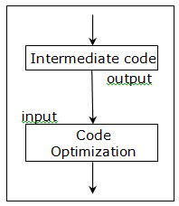
Code Optimization
Object program that are frequently executed should be fast and small. Certain compiler have within them a phase that tries to apply transformations to the output of the intermediate language version of the source program from which a faster or smaller object language program can be produced.

Slide 54
Code Optimization
There are several ways of code optimization
Local Optimization-
Loop Inversion- The local optimizations/transformations are applied to a program to attempt on improvement. Consider the following example
L1: If (A > B) then
goto L2
else
goto L3
L2: T1 = 2 * B
T2 = T1 – 5

Slide 55
Code Optimization
If (A < T2)
goto L4
else
goto L3
L4: A = A + B
goto L1
L3: Exit

Slide 56
Code Optimization
Here, we saw two instances of jumps over jumps in intermediate code such as
L1: If (A > B) goto L2 ……………………….. (a)
else
goto L3
L2:
This sequence could be replaced by the single statement
If (A < B) goto L3 ……………………….. (b)

Slide 57
Code Optimization
Sequence (a) would be replaced in the object program machine statement which
1) Compare A & B to set the condition codes,
2) Jumps to L2 if the code for > is set, and else
3) Jump to L3.
Sequence (b) would be translated to machine instruction which
1) Compare A & B to set the condition codes and
2) Jumps to L3 if the code for < or = is set.

Slide 58
Code Optimization
b) Common Sub-Expression Elimination- One of the important local optimization is Common Sub-Expression Elimination (CSE) is a compiler optimization that searches for instances of identical expression i.e. they all evaluate to the same value and analyses whether it is worthwhile replacing them with a single variable holding the computed value.
Consider the following example.
a = b * c + g; ……………………… 1
d = b * c * h; ……………………… 2
We are evaluating b * c in expression 1 and 2 so,
Here we can write as
temp = b * c;
a = temp + g;
d = temp * h;

Slide 59
Code Optimization
2) Loop Optimization-
Loop Invariant-
Loops are especially good target for optimization because programs spend most of their time in inner loops.
A typically loop improvement is to move computation that produces the same result each time around the loop to point in the program just before the loop is entered.
Then this computation is done only once each time the loop is entered, rather than one for each iteration of the loop.
Such a computation is called as loop invariant.

Slide 60
Code Optimization
Example- Consider the following code sample, where two optimization possibilities can be applied.
While (j < max-1)
{
j = j + (4 + array[K]) * pi + 5;
}
Here the calculation max-1 and (4 + array[K]) * pi + 5 can be moved outside the loop, and pre-calculated, resulting in something similar to:-

Slide 61
Code Optimization
int maxa = max – 1;
int calcval = j + (4 + array[K]) * pi + 5;
while (j < maxa)
{
J = j + calcval;
}
If a quantity is computed inside a loop during every iteration and if its value is the same for each iteration, it can vastly improve efficiency to host it outside the loop and compute its value just once before the loop begins.

Slide 62
Code Optimization
b) Induction Variable Analysis- An induction variable is a variable that gets increased or decreased by fixed amount on every iteration of a loop, or is a linear function of another induction variable.
Example- in the following loop, i and j are induction variables.
for (i=0; i<10; i=i+1)
{
S = 5 * i;
cout<<S<<endl;
}

Slide 63
Code Optimization
A common compiler optimization is to recognize the existence of induction variables and replace them with simpler computations. For example, the code above could be written by the compiler as follows, on the assumption that the addition of a constant will be cheaper than a multiplication.
j = 0;
for (i=1; i<= 10; i=i+1)
{
S = S + 5;
Cout<<S<<endl;
}

Slide 64
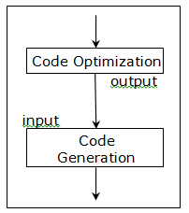
Code Generation
The code generation phase converts the intermediate code into a sequence of machine instructions.
A simple code generator might map the statement A := B + C into the machine code sequence,
LOAD B
ADD C
STORE A

Slide 65
Code Generation
However, such a straight-forward macro expansion of intermediate code into machine code usually produces a target program that contains many redundant loads stores and that utilizes the resources of the target machine inefficiently.
To avoid these redundant loads and stores, a code generator might keep track of the run-time contents of the registers.
The code generator can generate loads and stores depending on what quantity reside in registers.
Many computers have a few high speed registers in which computations can be performed particularly and quickly.
A good code generator would therefore attempt to utilize these registers as efficiently as possible. This aspect of the code generation is called register allocation.

Slide 66
Book Keeping / Symbol Table
A compiler needs to collect information about all the data objects that in the source program.
For example, a compiler needs to know whether a variable represents an integer or a real number.
What size an array has?,
How many arguments a function accepts?.
The information about data objects is collected by the early phases of the compiler, lexical and syntactic analysis and entered into the symbol table.

Slide 67
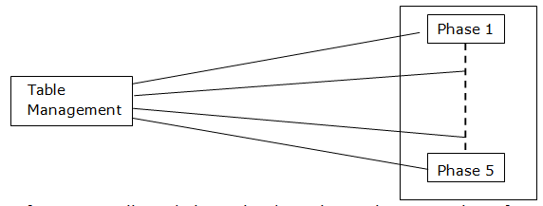
Book Keeping / Symbol Table
The information collected about the data objects has a number of uses.

Slide 68
Book Keeping / Symbol Table
For example, if we have the expression A + B, where A is of type integer and B of type real, and if the language permits an integer to be added to real, then on most computer code must be generated to convert A from type integer to type real before the addition can take place.
The addition done in floating point and the result is real.
If mix mode expressions of this nature are forbidden by the language, then the compiler must issue an error message when it attempts to generate code for this construct.

Slide 69
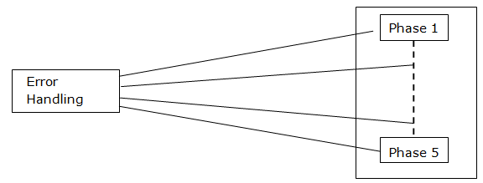
Error Handling
One of the most important functions of compiler is the detection and reporting of errors in the source program.
The error messages should allow the programmer to determine exactly where the errors have occurred. Errors can be encountered by virtually all of the phases of a compiler.

Slide 70
Error Handling
For example-
The lexical analyzer may be unable to proceed because the next token in the source program is misspelled.
The syntax analyzer may be unable to infer a structure for its input because a syntactic error such as missing parenthesis has occurred.
The intermediate code generator may detect an operator whose operands have incompatible types.
The code optimizer doing control flow analysis may detect that certain statements can never be reached.
The code generator may find compiler created constant that is too large to fit in a word of the target machine.

Slide 71
Error Handling
6. While entering information into the symbol table, the book keeping routine may discover an identifier that has been multiply declared with contradictory attributes.
Whenever a phase of the compiler discovers an error, it must report the error to the error handler, which issues an appropriate diagnostic message.
Once the error has been noted, the compiler must modify the input to the phase detecting the error, so that later can continue processing its input looking for subsequent error.

